Slide 1
Data compression and decompression scheme for on-chip communication
Saksham Kiroriwal (1520925)
Supervising Professor: Prof. Dr.-Ing. Roman Obermaisser
Supervising Tutor: Dr. Daniel Onwuchekwa

Slide 2
Contents:
Data Compression:
Introduction
Measurement of Performance
Explanation of compression algorithms
Vivado Simulation
XML Parser
Types of Parsers
XML and XML schema for the project
C++ Program for the Parser
Parser Output

Slide 3
Introduction
Increased data storage demands
Less usage of bandwidth after compression of data
Early examples: Morse code, Braille
Lossless Compression:
Huffman coding
Adaptive Huffman coding
Arithmetic coding
Lossy Compression:
Image, Video, Audio

Slide 4

Information theory
In the information theory, Claude Elwood Shannon defined a quantity called “self-information”.
Self information is defined by:
Another important quantity is entropy. Entropy is the average self-information associated with the experiment.

Slide 5
Measurement of Performance
One way of expressing the performance of the compression is compression ratio.
It is simply the ratio of the number of bits required to represent the data before and after the compression.
Another way of describing the compression ratio is by reducing the amount of data needed as a percentage of the original size

Slide 6
Terminology
Prefix Codes: These codes are prefix codes and are optimum for a given model (set of probabilities). Prefix codes are codes in which no code is a prefix of another code.
Prefix Codes are uniquely identifiable.
Optimum Code:
In an optimum code, symbols that occur more frequently (have a higher probability of occurrence) will have shorter code words than symbols that occur less frequently.
In an optimum code, the two symbols that occur least frequently will have the same length

Slide 7
Lossless Compression Techniques
Huffman Coding
Adaptive Huffman Coding
Canonical Huffman Coding
Tunstall Coding
LZ77
DEFLATE

Slide 8
Huffman Coding
Developed by David Huffman
It is variable length coding. These codes are prefix codes and are optimum for a given model.
The algorithm is as follows:
Select two symbols with the least frequency and place the one with the larger frequency out of the two, on the right. The left child has less frequency than the right child.
The probability of the parent node is equal to the sum of the probabilities of the children.
Move the parent node with new probability up the tree, according to step 1.
Repeat the steps until all the elements are put in the tree.

Slide 9
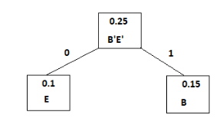
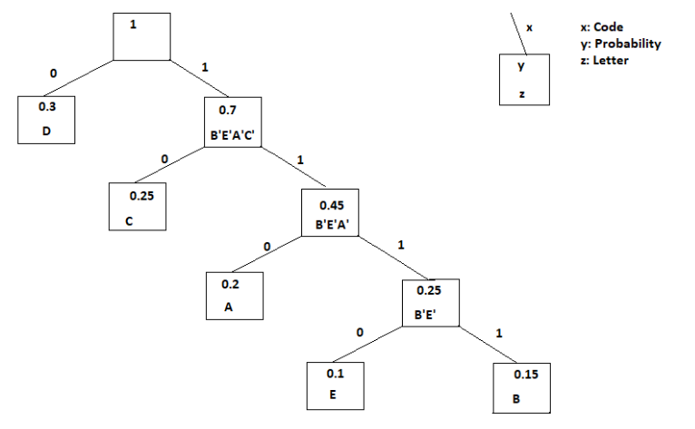
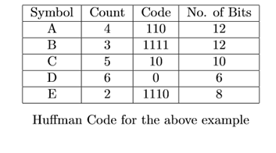
Huffman Coding Example
Consider the an alphabet S= {ABCDABCCCEDAABCDEDDD}. The probability distribution for the elements is P(A)=0.2, P(B)=0.15, P(C)= 0.25, P(D)= 0.3, P(E)= 0.1.

Slide 10
Adaptive Huffman Code
Huffman Coding requires the knowledge of probability distribution of symbols before the compression. In adaptive Huffman coding, prior knowledge is not required.
For adaptive Huffman coding, two new parameters were introduced, weight and node number.
Disadvantages of Huffman Code
Coding on the fly
Difficult to implement on hardware
Prone to more errors

Slide 11
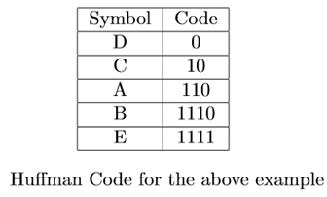
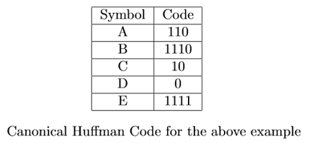
Canonical Huffman Code
In Canonical Huffman coding, the bit lengths of the standard Huffman codes generated for each symbol is used. The symbols are sorted first according to their bit lengths in non-decreasing order and then for each bit length, they are sorted lexicographically.

Slide 12
Tunstall Code
It is fixed length code. i.e. all code words are of equal length.
Also dependent on probability distribution
Assigns codes to a set of symbols depending on the probability
Algorithm:
Decide the length of the Tunstall Code that you wish to make
The symbols are arranged in the descending order of the probabilities
The one with the highest probability is combined with the other symbols. The probability of the new set of symbols is equal to the product of the probabilities of the two symbols.
Now, these sets of symbols are considered as a separate symbol and the probabilities are compared with other others’
The same procedure is repeated until we arrive at the maximum possible number of entries

Slide 13
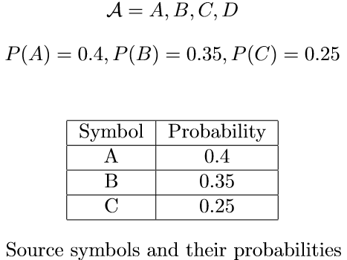
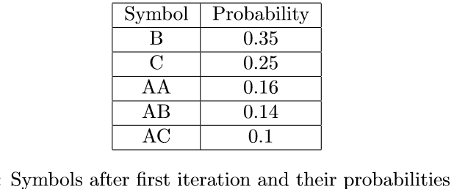
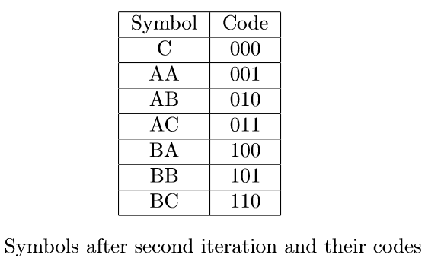
Tunstall Code Example

Slide 14
LZ77
It is a dictionary based coding technique in which a sliding window is maintained.
The sliding window comprises of the search buffer and the look ahead buffer.
The encoding and decoding is done from the sliding window, based on the previously seen characters.
The encoding of each repeated character is shown by {length-distance pair}.
A dictionary is maintained of the phrases that are found and it is then appended to the final file.
The length of the dictionary is fixed to a certain value.
Main applications include implementation of LZ77 in DEFLATE compression technique

Slide 15
DEFLATE
This specification defines a lossless compressed data format that compresses data using a combination of the LZ77 algorithm and Huffman coding.
DEFLATE works in two phases. The data is divided into blocks. Each block is preceded with a 3-bit header.
In the compressed blocks, LZ77 and Huffman algorithm are applied.
New 9 bit codes were defined for {length-distance} numbers.
The implementation is complex than Huffman algorithm. We focus on implementation of Huffman Coding on FPGA.

Slide 16
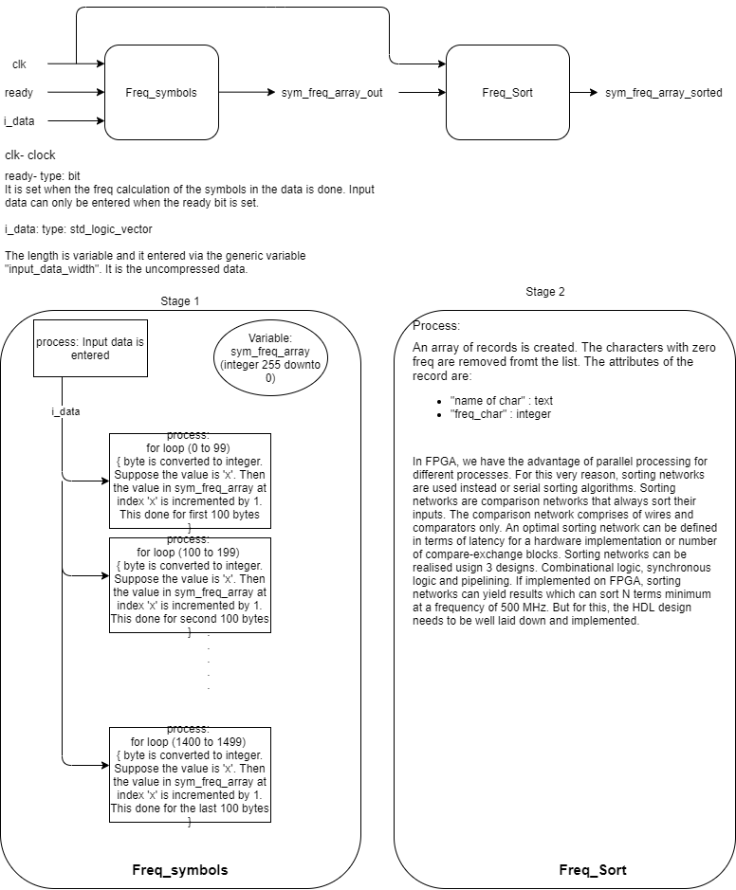
Simulation of VHDL code for Huffman Coding
In the first stage, instead of reading a stream of data, all of the data is read in one clock cycle since the data is stored in a memory-mapped register.
After receiving the data, the std logic vector type data is converted into an unsigned integer type. A frequency calculation procedure is defined. During the procedure call, the values in integer type input are read. The value in "symbol freq" at index number same as the value in the integer input data is incremented by one.
Once the input data is ready in the integer format, the frequency calculation procedure is called in multiple parallel running processes. An array, named "symbol freq", of length 255 downto 0 of type integer is maintained.
The same procedure is repeated for the complete data. By converting the input data to integer the frequency calculation of the symbols becomes easier as the input value actually maps to the index in "symbol freq" array.
At the end of the second clock cycle, we are able to receive the frequency of the symbols in the data.

Slide 17
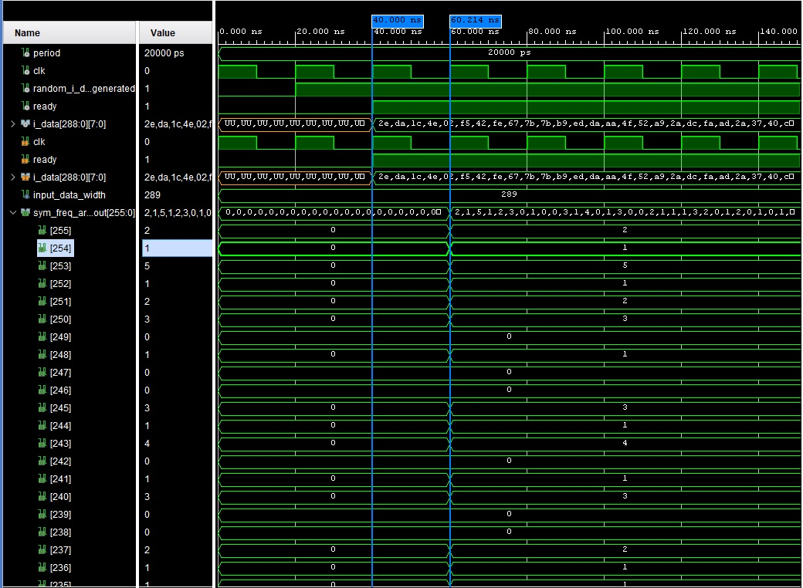

Slide 18
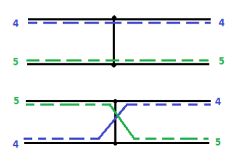
Sorting Network
Sorting Networks comprise of comparators and wires. They differ from general comparison sorting algorithms in the sense that they are not capable of handling input lengths larger than what they are designed for.
Example of an exchange block:
The sequence of comparisons is set prior and is independent of the result of the comparisons. This makes sorting networks more suitable for hardware implementation as parallel processes can be implemented to execute the sorting network.
In sorting network, wire run from left to right and carry one value at a time.
A comparator is shown by vertical line joining two wires.
If the wire encounter a comparator, the comparator swaps the values if and only if the top wire's value is greater or equal to the bottom wire's value.

Slide 19
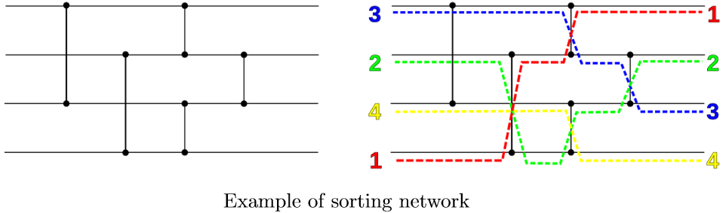
Larger sorting networks can be built out of multiple compare-exchange blocks connected properly.
Below figure is an example of a sorting network for N=4, it has size 5 and depth 3

Slide 20
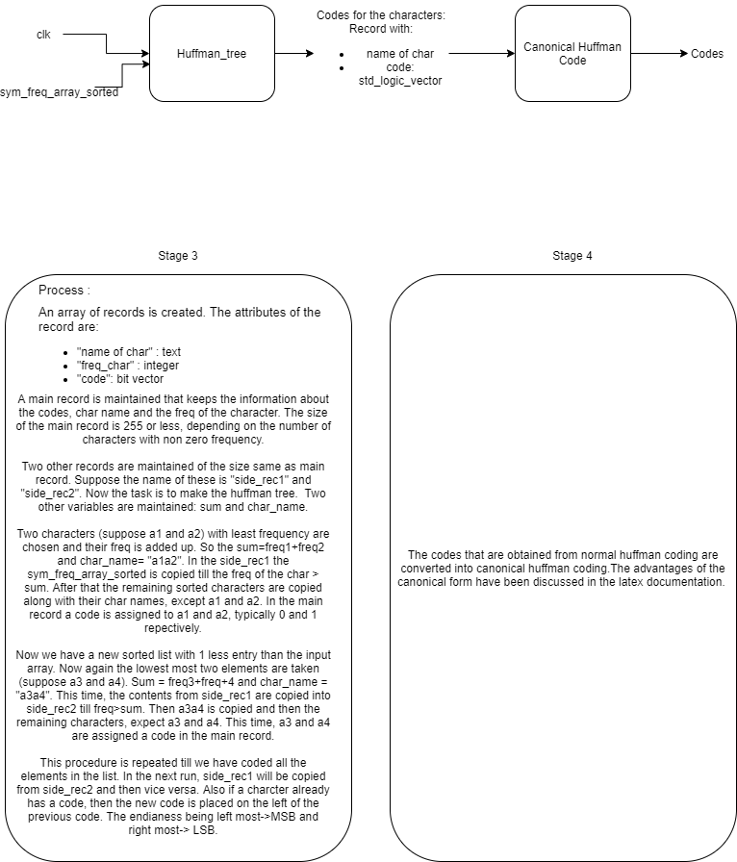
Further stages for the implementation of Huffman Coding
Codes can be developed for the stages and can be further simulated

Slide 21
XML Parser
Types of Parsers:
SAX Parser(Simple API for XML)
DOM Parser
Libraries used:
Libxml++2.6
Glibmm-2.6
Pthread
XML DTD
Stands for Document Type Definition
A DTD defines the structure and the legal elements and attributes of an XML document.
An XML document validated against a DTD is both "Well Formed" and "Valid".
With a DTD, independent groups of people can agree to use a standard DTD for interchanging data
XML Schema
An XML Schema describes the structure of an XML document, just like a DTD.
An XML document validated against an XML Schema is both "Well Formed" and "Valid".
One of the greatest strengths of XML Schemas is the support for data types
Describing document content is easier, restrictions on data can be defined

Slide 22
XML Parser
An XML Parser (SAX Parser) was to be implemented using C++ for hardware and port configuration files for the programming of FPGA.
The specification of the configuration files was given by the mentor.
Step 1: Coming up with a suitable XML grammar and XML structure for the same
Step 2: Code for class inheritance in compliance to the XML structure
The element names become the class and the attributes and values of the elements are stored as the attributes of that class
Multiple occurrences of a particular element is stored as objects of that class
Step 3: Method definition for the above defined classes
These methods use the methods of the XML parser library and some user defined functions too
They define what needs to be done when an element, attribute or node is encountered
They are also dependent on the grammar of the XML file
Step 4: Values stored inside the object and attributes are printed in the desired file

Slide 23
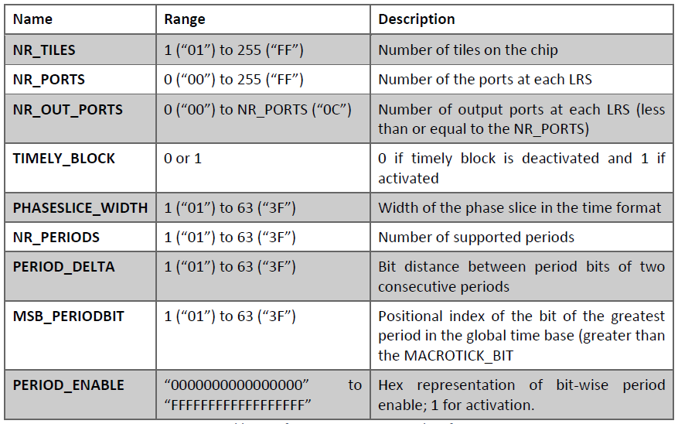
XML element specifications

Slide 24
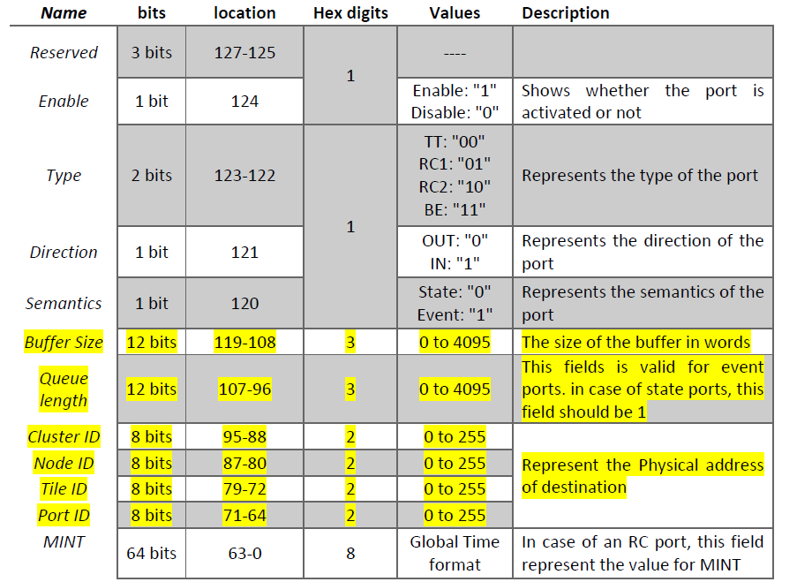

Slide 25
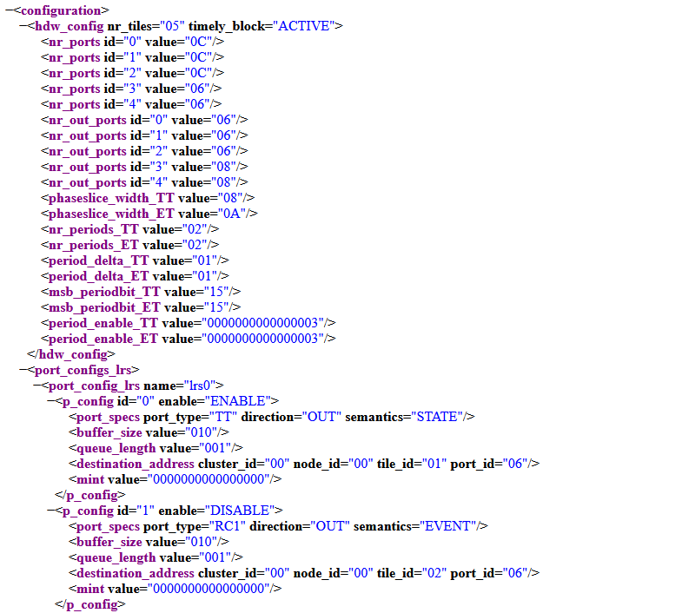
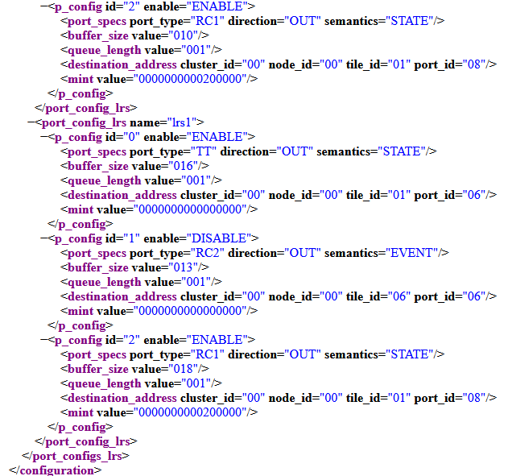

Slide 26
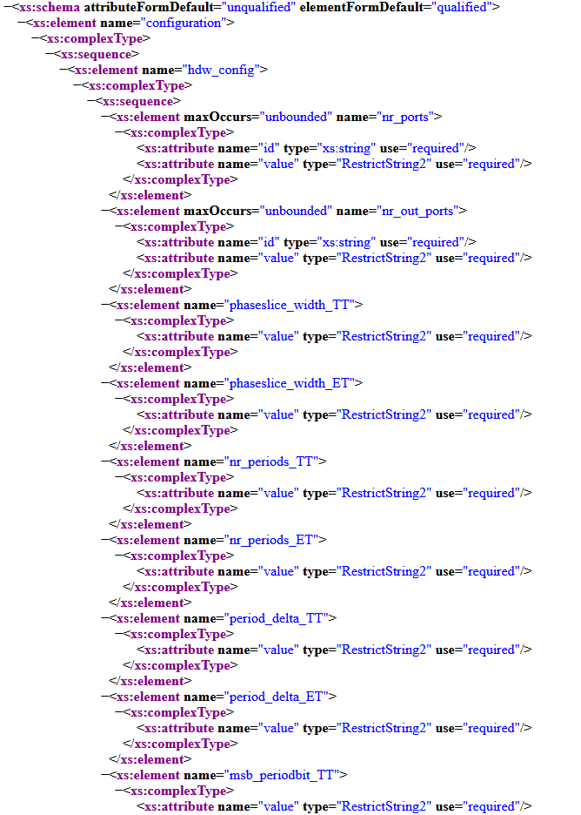
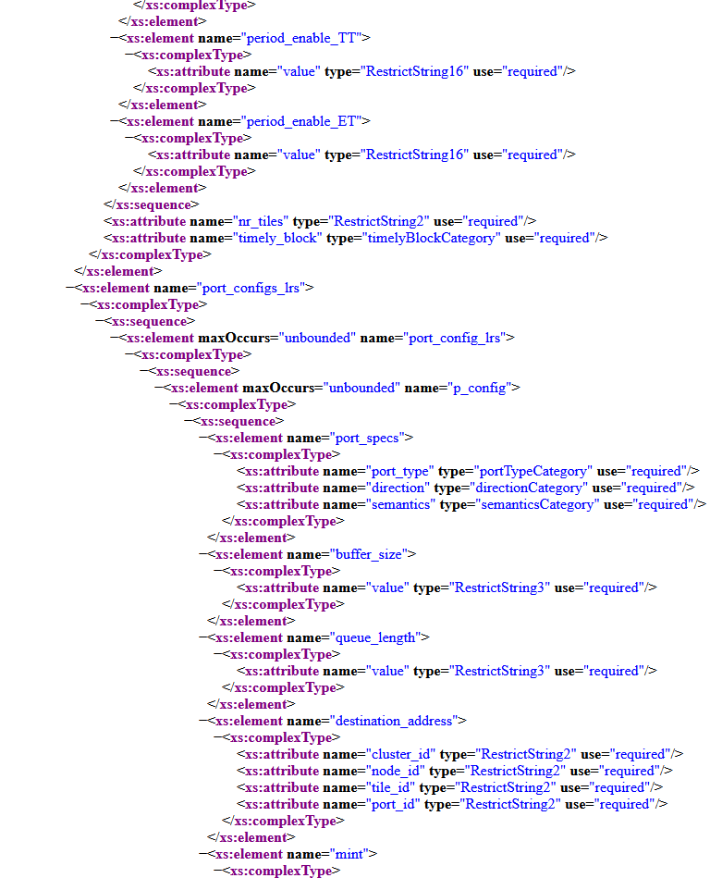
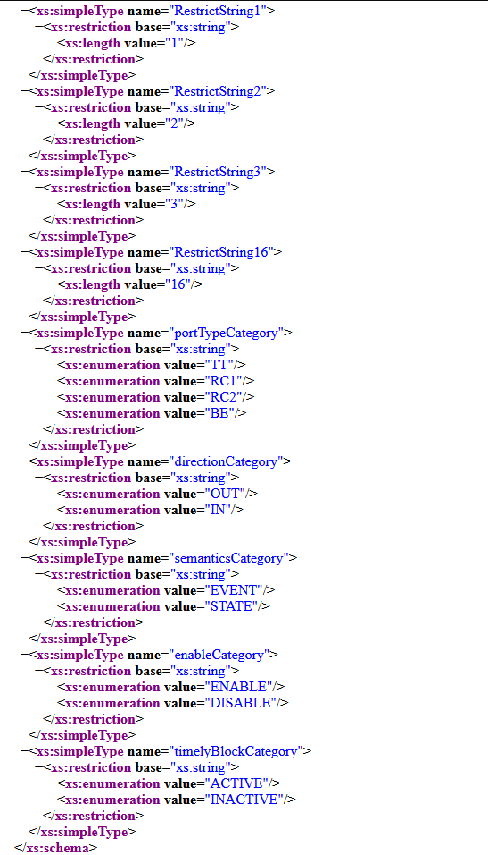

Slide 27
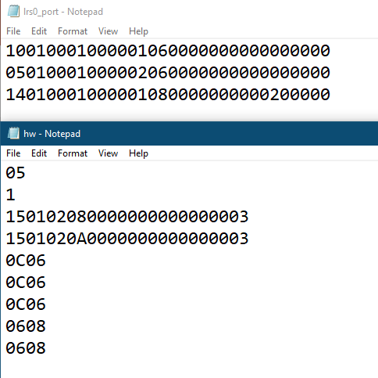
The C++ code is included in the submission files.
Output configuration files

Slide 28
Thank you for your kind attention.

